Slide 1
Collide
Your next best friend is just around the corner
Notes:
Hi, my name is Ekin Tiu, and today I’m going to be presenting our project and mobile app, Collide, where your next best friend is just around the corner

Slide 2
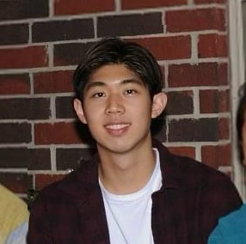
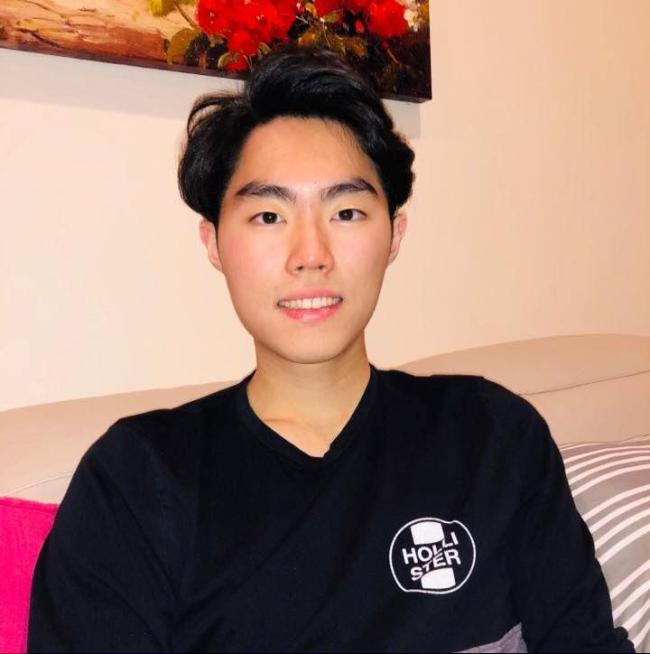
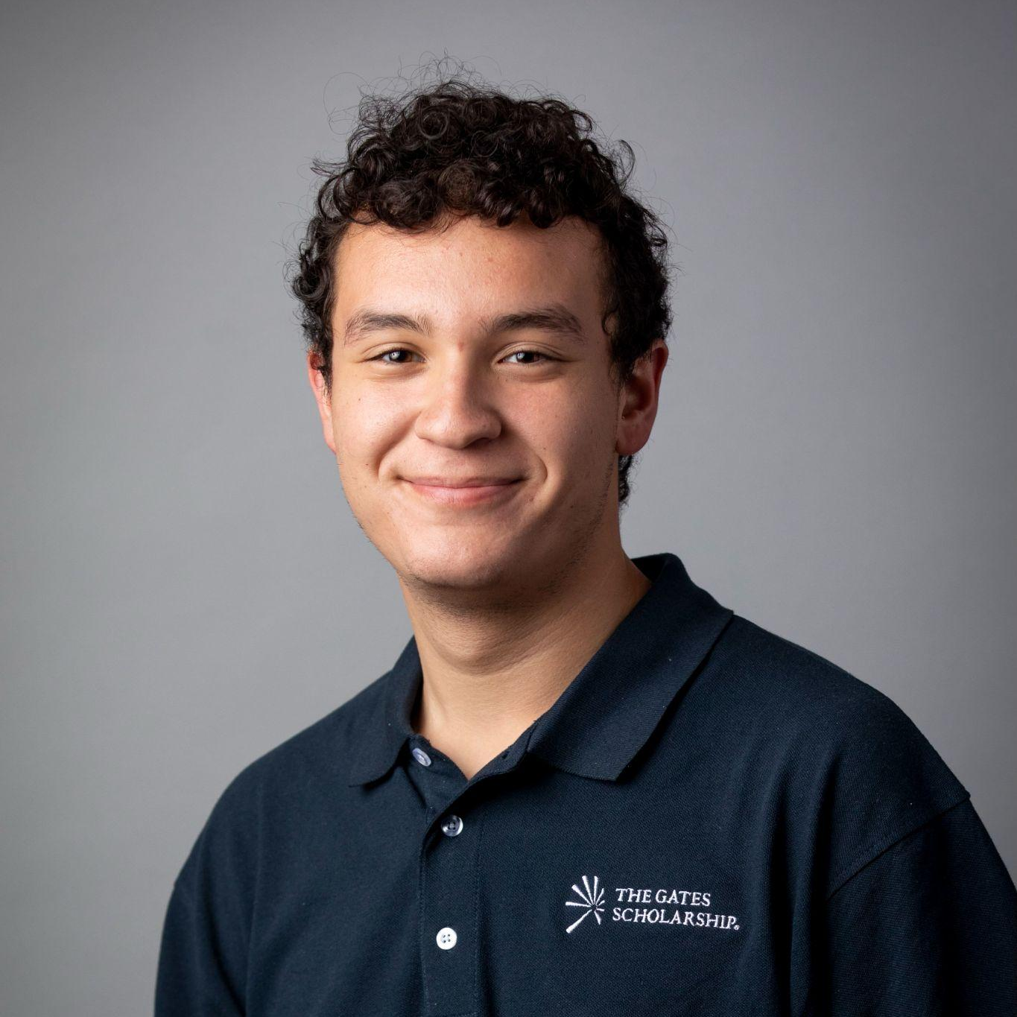
Team
Intro > HE > Revisions > Prototype > Demo
Emily H. CS (2024)
Taipei, Taiwan
Ekin T.
CS (2024)
Houston, TX
Enok C. CS (2023)
Leonia, NJ
Christian F. CS (2023)
Wasco, CA

Slide 3
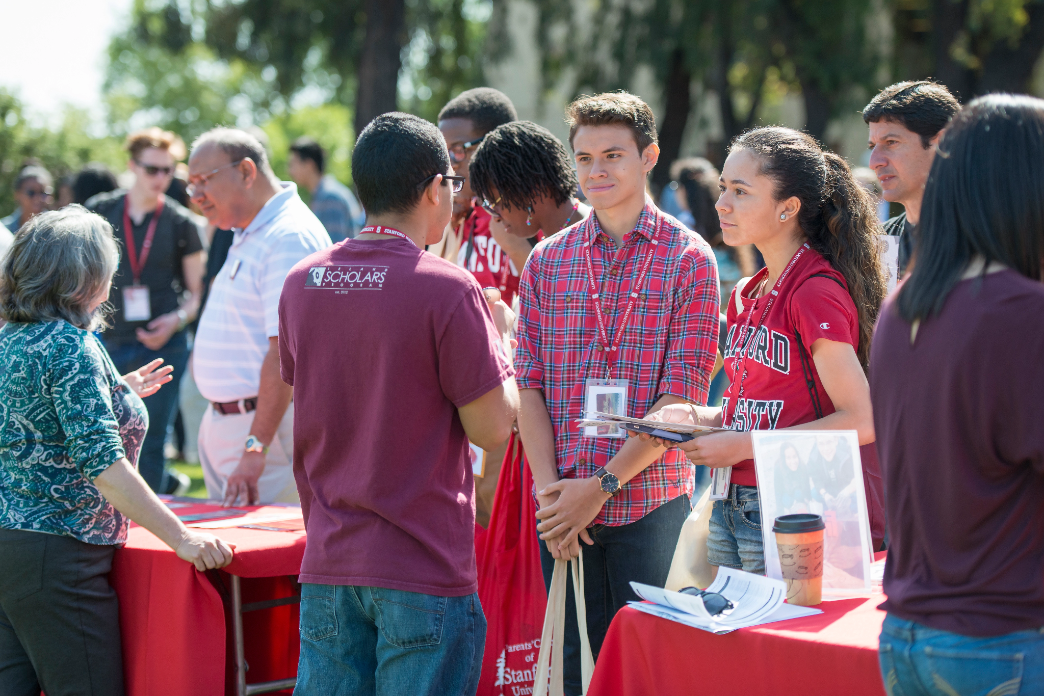
The Problem
Intro > HE > Revisions > Prototype > Demo
When transitioning to a new environment, people find it difficult to make meaningful connections and are fearful of reaching out.
Notes:
When transitioning to a new environment, whether it be college

Slide 4
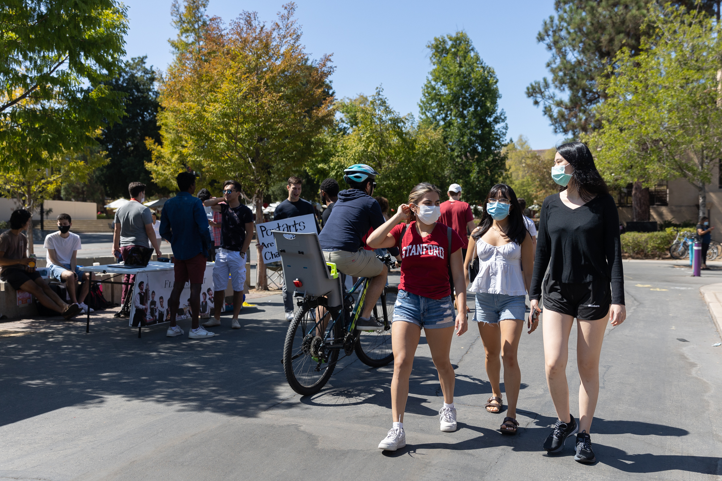
Our Solution
Intro > HE > Revisions > Prototype > Demo
We want to solve this by creating opportunities for people, who would have otherwise passed by each other, to stop and talk.
Notes:
Take a second to think about the number of people that pass you daily. Wouldn’t it be a shame if that person shared interests with you? Collide aims to change this.

Slide 5
Your next best friend is right around the corner

Slide 6
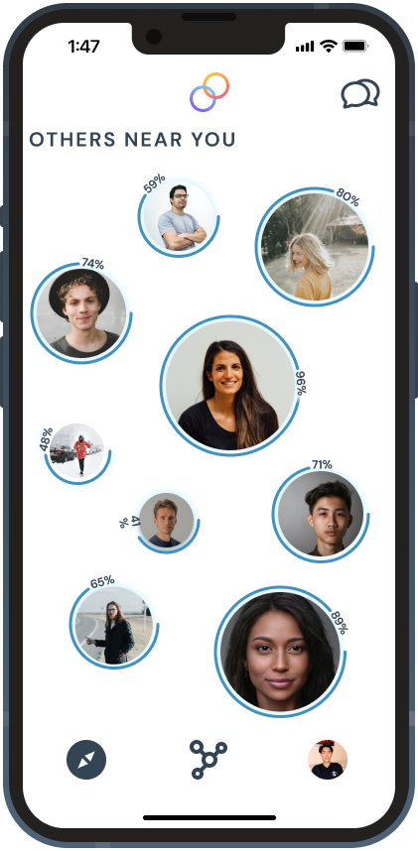
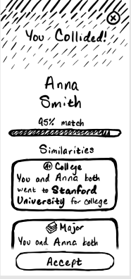
Our Journey
Intro > HE > Revisions > Prototype > Demo
?
Heuristic
Evaluation
User Testing
Low-Fi Prototype
Med-Fi Prototype
Hi-Fi Prototype
Notes:
But in order to understand how we’re building out this solution, it’s useful to provide some context on our journey thus far. So today, we want to see how heuristic evaluation directly translated to changes made on our hi-fi prototype

Slide 7
1
Heuristic Evaluation
2
Design Revisions
3
Prototype Implementation

Slide 8
Heuristic Evaluation Thematic Summary
Intro > HE > Revisions > Prototype > Demo
🔒
👀
👨‍🦯
Privacy
Clarity of System Status
Accessibility

Slide 9
Category | # Viol. Sev 3 | # Viol Sev 4 | # Viol. (total)
H1: Visibility of Status | 4 | 2 | 6
H2: Match Sys & World | 3 | 0 | 3
H3: User Control | 3 | 1 | 4
H4: Consistency & Standards | 0 | 0 | 0
H5: Error Prevention | 1 | 0 | 1
H6: Recognition not Recall | 2 | 0 | 2
H7: Efficiency of Use | 1 | 0 | 1
H8: Minimalist Design | 1 | 2 | 3
H9: Help Users with Errors | 1 | 0 | 1
H10: Help & Documentation | 3 | 2 | 5
H11: Accessible | 4 | 1 | 5
H12: Fairness & Inclusion | 0 | 1 | 1
H13: Value Alignment | 0 | 2 | 2

Slide 10
Category | # Viol. Sev 3 | # Viol Sev 4 | # Viol. (total)
H1: Visibility of Status | 4 | 2 | 6
H2: Match Sys & World | 3 | 0 | 3
H3: User Control | 3 | 1 | 4
H4: Consistency & Standards | 0 | 0 | 0
H5: Error Prevention | 1 | 0 | 1
H6: Recognition not Recall | 2 | 0 | 2
H7: Efficiency of Use | 1 | 0 | 1
H8: Minimalist Design | 1 | 2 | 3
H9: Help Users with Errors | 1 | 0 | 1
H10: Help & Documentation | 3 | 2 | 5
H11: Accessible | 4 | 1 | 5
H12: Fairness & Inclusion | 0 | 1 | 1
H13: Value Alignment | 0 | 2 | 2

Slide 11
22
Severity 3/4 Issues
Notes:
While we looked at ½ issues, we decided it was the best use of time to primarily focus on fixing ¾ issues more thoroughly

Slide 12
Heuristic Evaluation Examples
Intro > HE > Revisions > Prototype > Demo
H1 Visibility of system status / Severity 3
On the “You collided!” page, users can click x in the top right to exit. It is unclear whether the location sharing stops after clicking x or not.
Fix: Make it clear to the user whether the location sharing stops or not after clicking x
H13 Value alignment / Severity 4
One of the values of the app is privacy. However, users have no collected way of knowing what type of information is being shared and who can see it.
Fix: Add an information page that shows what data is being shared and who is able to see it.

Slide 13
Revision Methodology
Intro > HE > Revisions > Prototype > Demo
Moved things from heuristic eval doc to team analysis doc
Ran through all of the fixes one by one, see which one’s were high severity and doable

Slide 14
22
Severity 3-4 Issues
9
Major Design Revisions
As of 3/4/22
Notes:
Out of these, we addressed 9 with major design revisions as we saw fit, and were split up rather evenly per task

Slide 15
1
Heuristic Evaluation
2
Design Revisions (Per Task)
3
Prototype Implementation

Slide 16
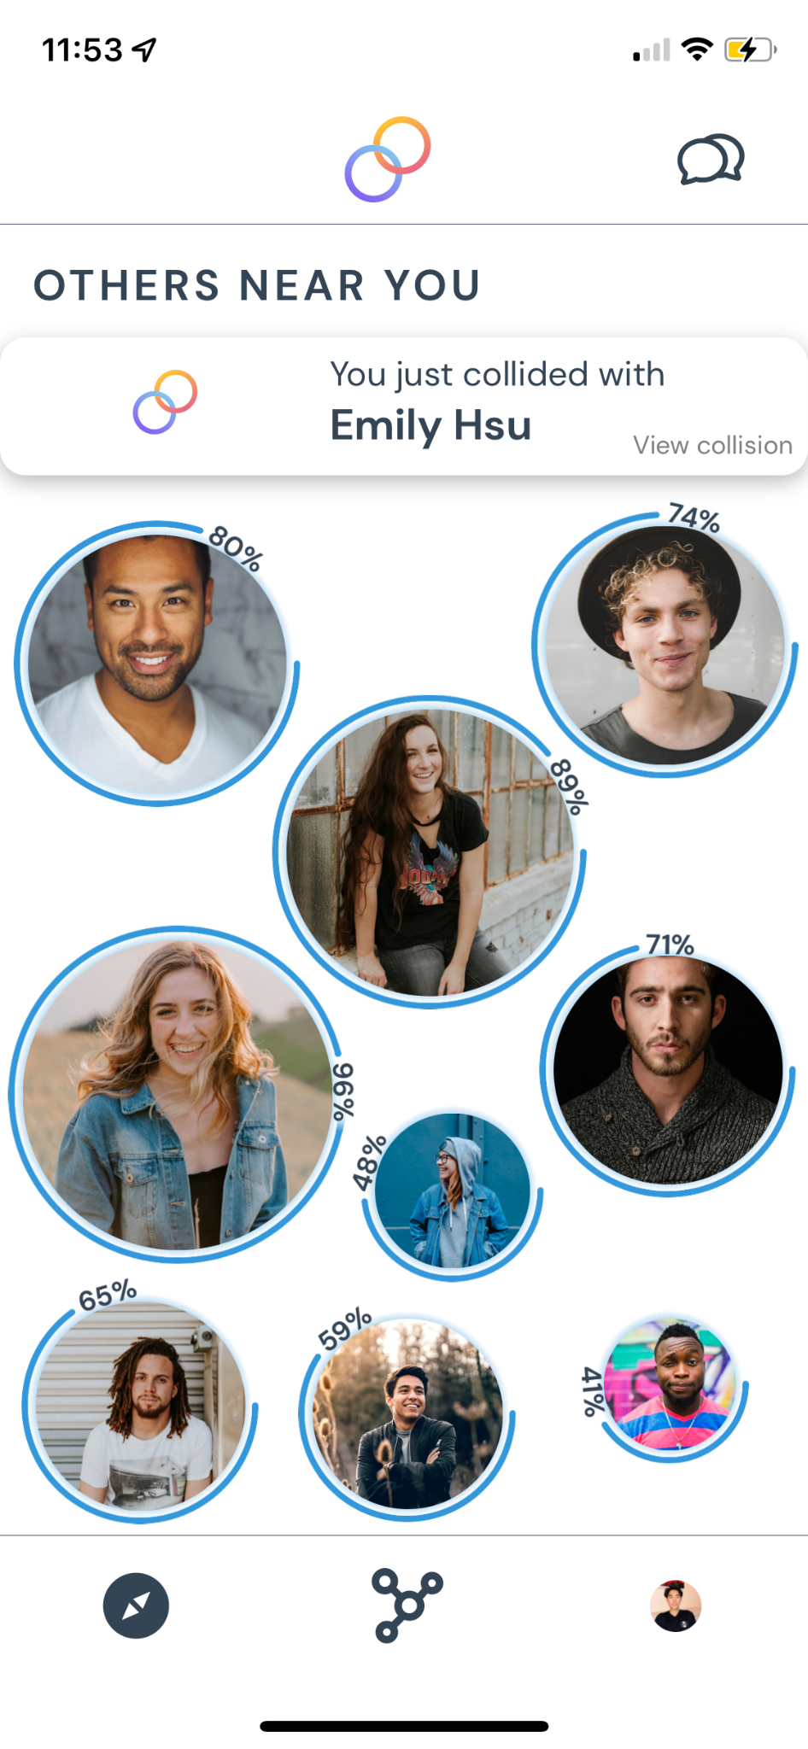
Task 1
Befriend someone near you with similar interests

Slide 17
⚠️VIOLATION 1.1 – Severity 4
Not clear what “Add to Network” means (H2)
Intro > HE > Revisions > Prototype > Demo
Confusing if this is an action users perform before or after meeting in-person

Slide 18
Intro > HE > Revisions > Prototype > Demo
🛠️ REVISION 1/9
Change
“Add to Network” to
“Send Friend Request”
Makes the process explicit
Builds off of user’s conceptual model from other social media platforms

Slide 19
⚠️VIOLATION 1.2 – Severity 4
No option to specify gender in profile (H12)
Intro > HE > Revisions > Prototype > Demo

Slide 20
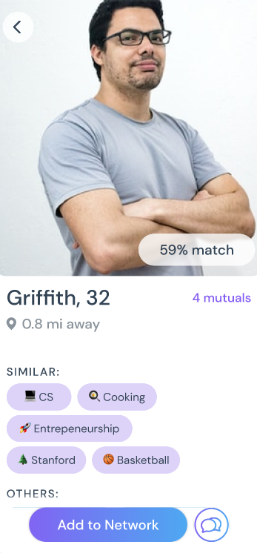
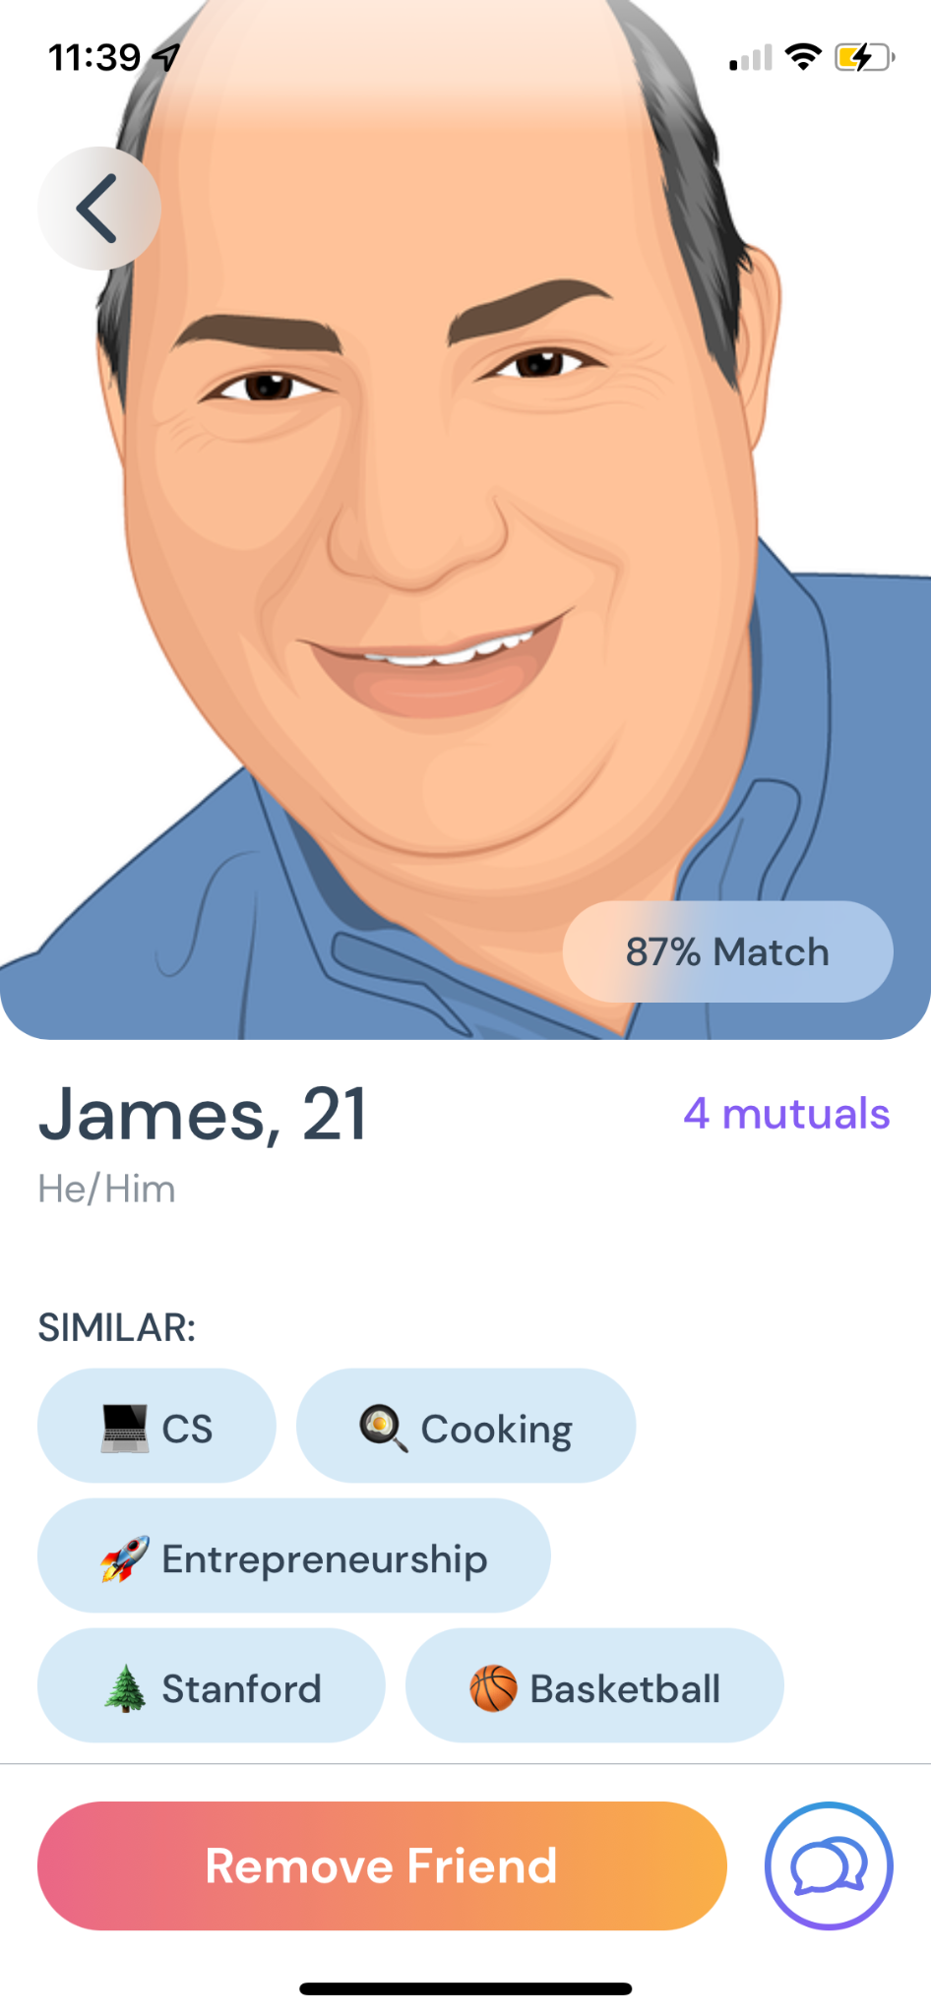
Intro > HE > Revisions > Prototype > Demo
🛠️ REVISION 2/9
Add gender pronouns to people’s profile bio
Highlights inclusivity
Ensures all users are safe and heard

Slide 21
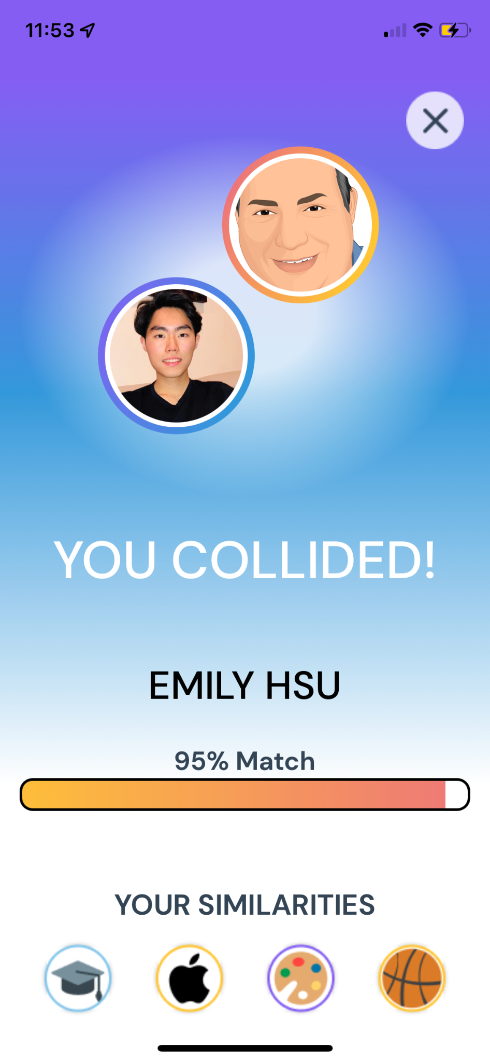
Task 2
Start a conversation with a collision in person

Slide 22
⚠️VIOLATION 2.1 – Severity 3/4
Privacy and Information Sharing
Information shared is not specified when entering collision (H3)
Clarity on Location Sharing (H1)
Lack of information on Privacy (H10) ← Unimplemented
Intro > HE > Revisions > Prototype > Demo

Slide 23
🛠️ REVISION 3/9
Specify in collision notification that they will only view collision
Alleviate fear of accepting a collision unwantedly
Notes:
People want to know at every step of the way, if their location is being shared

Slide 24
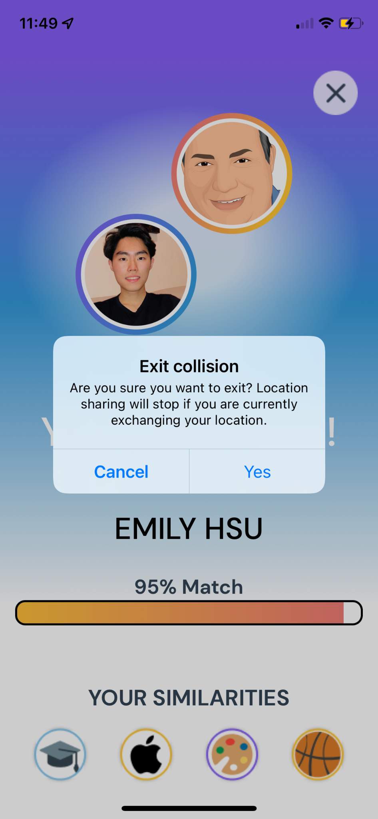
🛠️ REVISION 4/9
Add modal to clarify location sharing
When exiting, people will now know that their location will stop sharing

Slide 25
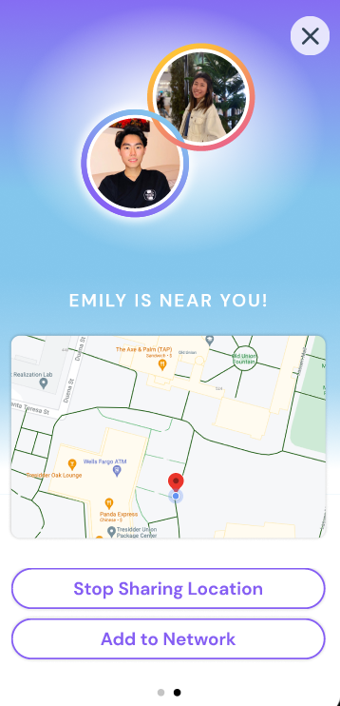
⚠️VIOLATION 2.2 – Severity 3
Shared Interests Disappear when Location is Exchanged (H6)
Intro > HE > Revisions > Prototype > Demo
People forget what interests they had in common with their collision when they meet in person

Slide 26
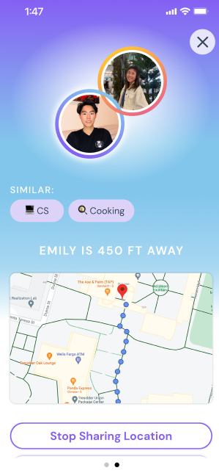
🛠️ REVISION 5/9
Add shared interests to location page
Makes it easy for users to recognize the type of person they are about to talk with

Slide 27
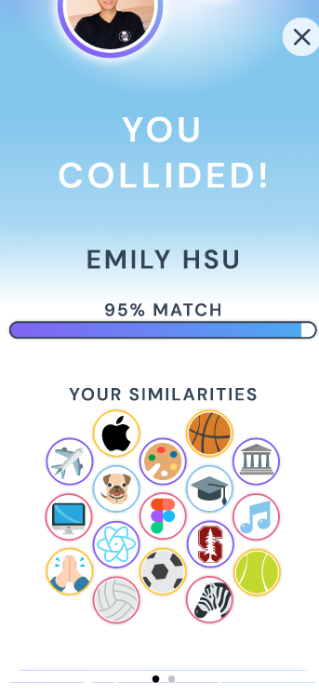
⚠️VIOLATION 2.3 – Severity 4
Shared Interests are Only Visual (H11)
Intro > HE > Revisions > Prototype > Demo
Doesn’t accommodate visually impaired
Notes:
❗

Slide 28
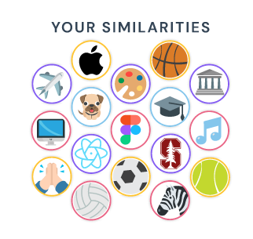
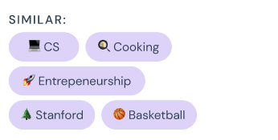
🛠️ REVISION 6/9
Add text to shared similarity icons
Make it more readable and understandable to a broader audience

Slide 29
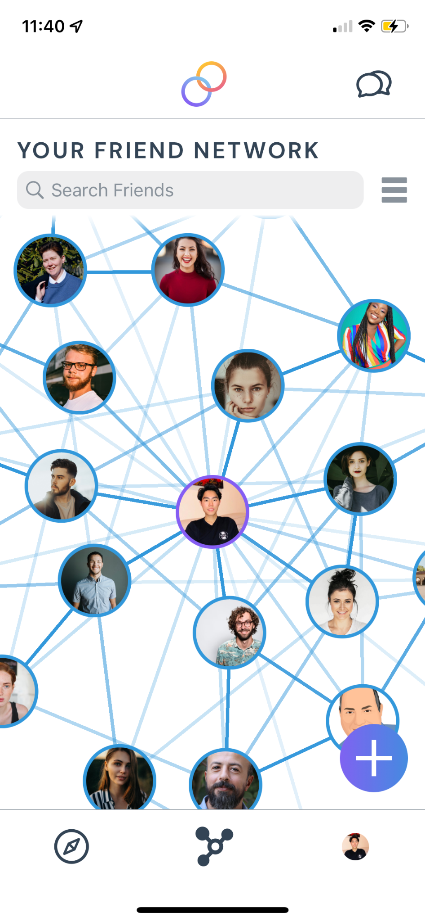
Task 3
Connect with and reach out to a past friend

Slide 30
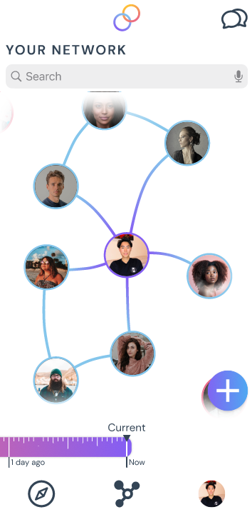
⚠️VIOLATION 3.1 – Severity 3
Network timeline doesn’t match real world understanding (H2)
Intro > HE > Revisions > Prototype > Demo
Backward scrolling unclear
Notes:
Problem Description: The timeline ruler could be more intuitive, as the spacing and the time periods are variable for the same amount of space on the ruler.
Rationale: I found the ruler structure to be a bit confusing as an initial user and even as an experienced one as I played with the prototype more.

Slide 31
Intro > HE > Revisions > Prototype > Demo
🛠️ REVISION 7/9
Remove timeline altogether
Though it was a cool concept (thanks Christian), we removed it to eliminate potential confusion from the users’ end

Slide 32
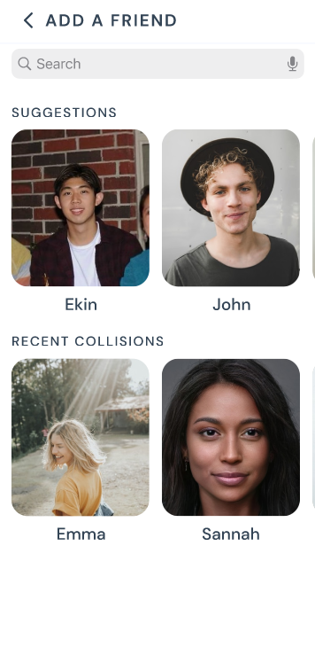
⚠️VIOLATION 3.2 – Severity 3
Not enough information to describe another user (H5)
Users were only labeled with their first name
Intro > HE > Revisions > Prototype > Demo

Slide 33
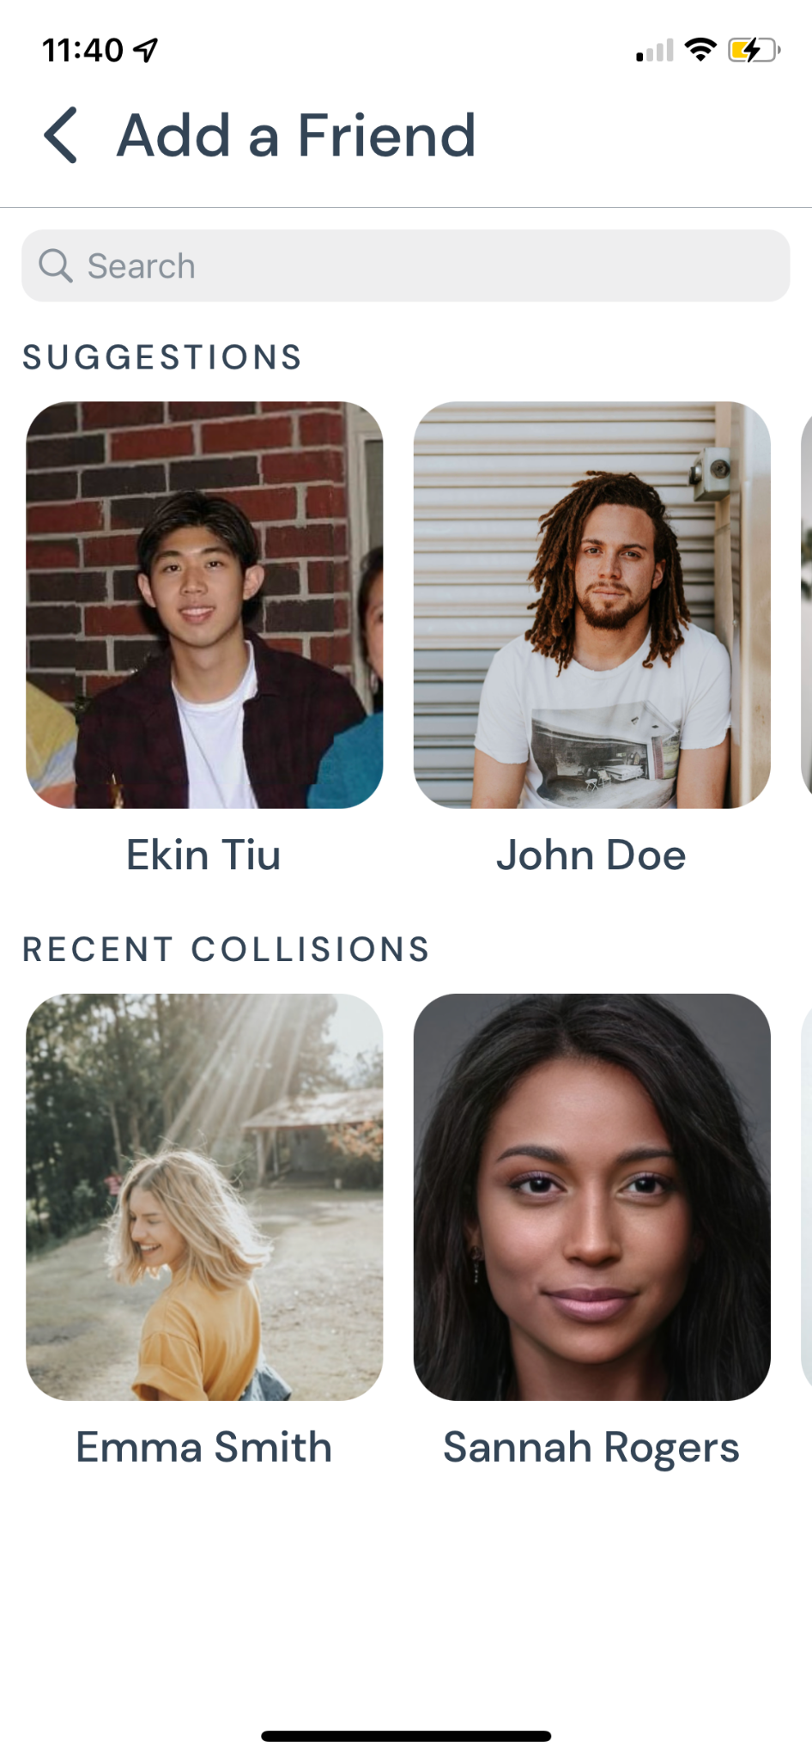
Intro > HE > Revisions > Prototype > Demo
🛠️ REVISION 8/9
Add last names to other user’s profiles
Helps users differentiate between users to prevent error – i.e. choosing wrong person

Slide 34
VIOLATION 3.3 – Severity 4
Network Graph is only Visual (H11)
Information is not accessible for visually impaired users
Intro > HE > Revisions > Prototype > Demo

Slide 35
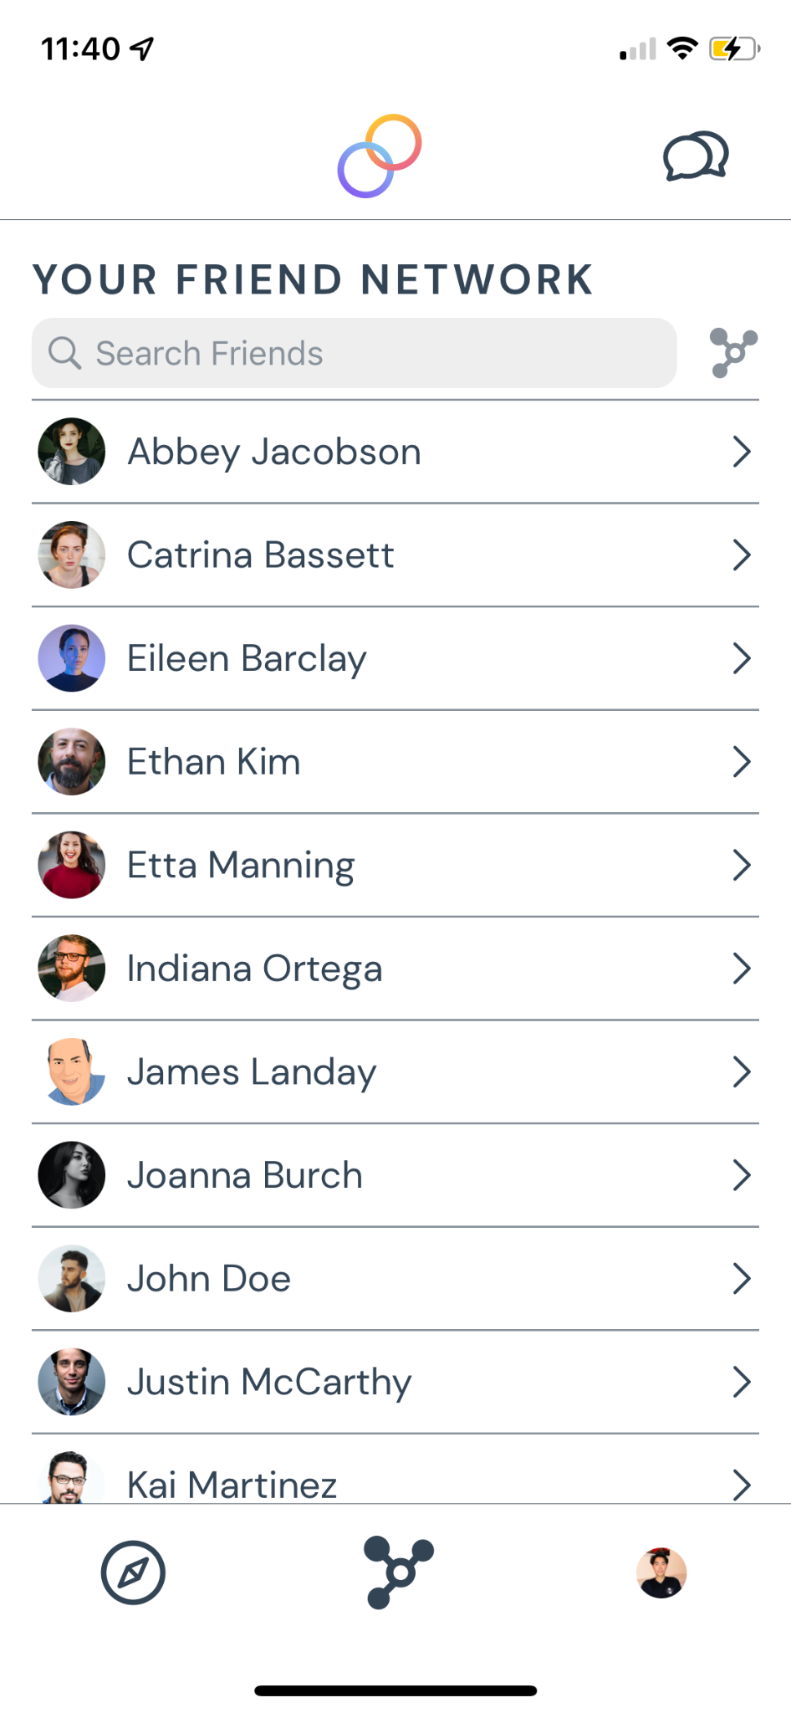
Intro > HE > Revisions > Prototype > Demo
🛠️ REVISION 9/9
Add toggle to list view of friend network
Use toggle button to switch from graph to list interface

Slide 36
❗ Violations Not Addressed
Intro > HE > Revisions > Prototype > Demo
Violations that were med-fi prototype specific (related to tasks)
I.e. After clicking “Add to Network,” users receive a popup that says “Task completed!” However, users may be confused on what a “task” is.
Help and information related violations
Edge cases that the app doesn’t allow
I.e. dealing with multiple collisions at a time
.
Notes:
Was just for indicating completion of the task for the purposes of the assignment-- will remove for the actual app
to fix this, we can have a tutorial upon the user opening the app for the first time, but for given the time constraints we will not implement this.
False positive violations (we had them already in our med-fi)
i.e. Users can click on “Add to Network” and the button changes to “Request Sent.” However, there’s no way to unsend a request

Slide 37
1
Heuristic Evaluation
2
Design Revisions
3
Prototype Implementation

Slide 38
Framework & Tools
Figma
Med-Fi
React Native & Expo
Hi-Fi
Notes:
We use figma for prototyping
We use react native and expo for developing, expo helps us test fast, built on top of react native

Slide 39
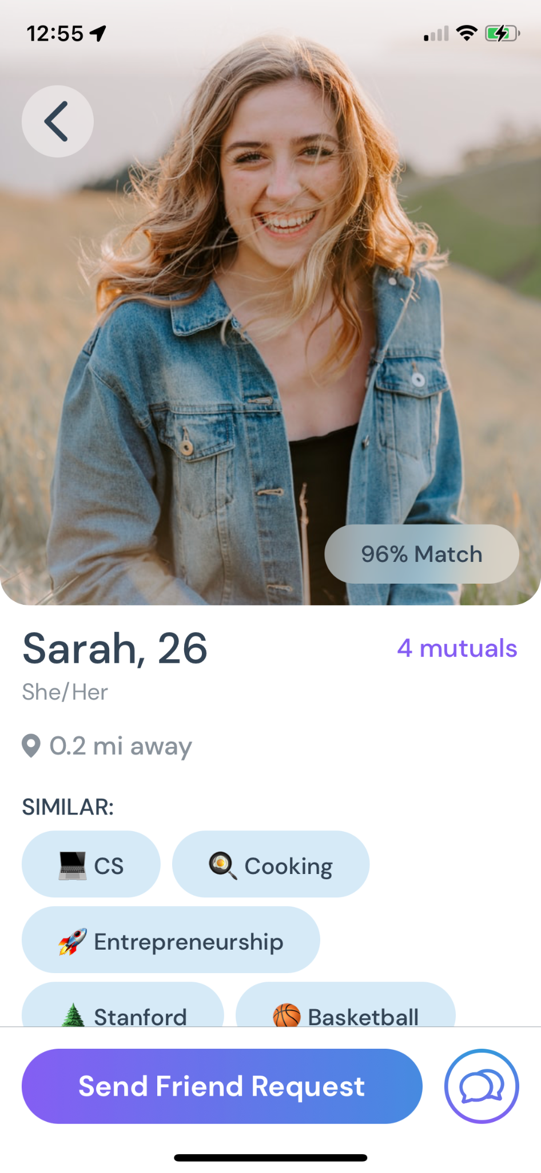
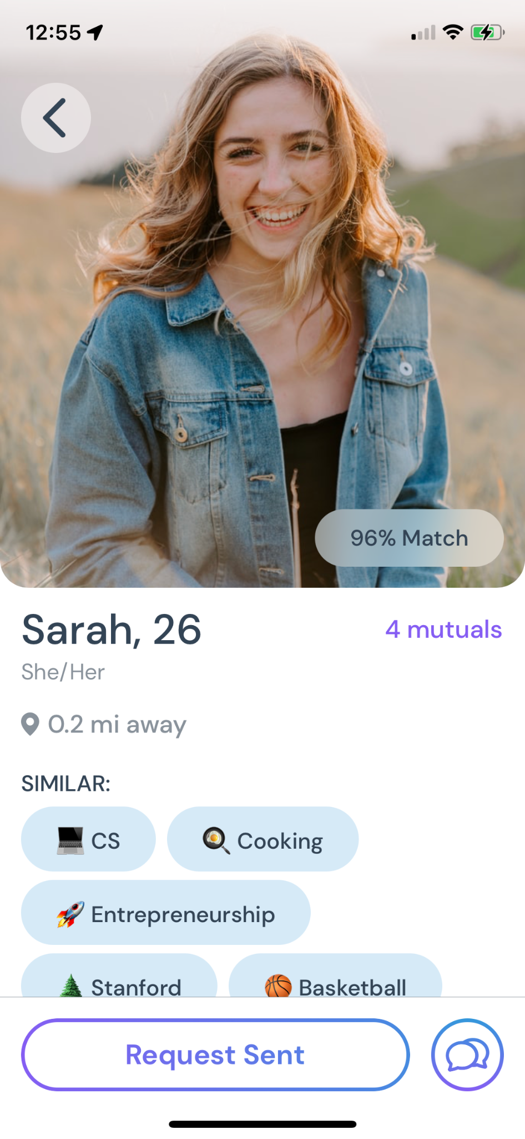
Befriend someone near you with similar interests
✔️ Simple Task 1 is Finished
Intro > HE > Revisions > Prototype > Demo

Slide 40
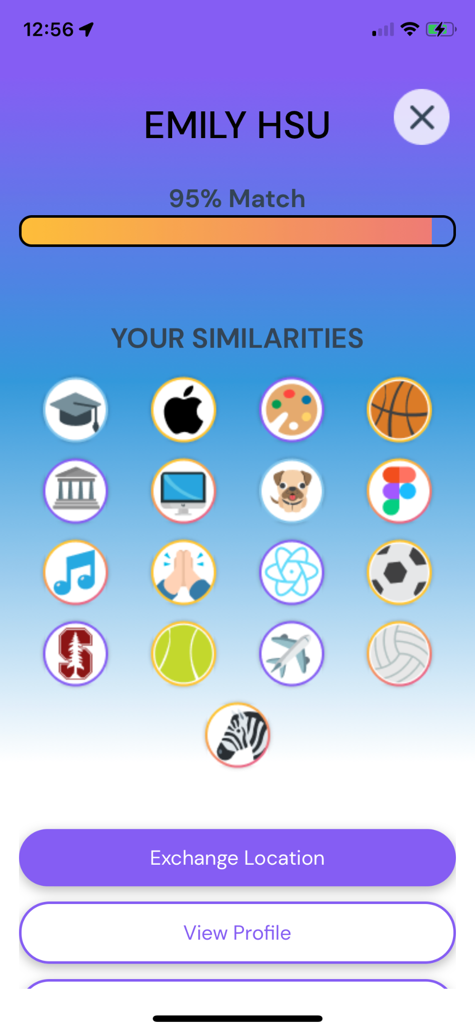
🚧 Moderate Task 2 is a Work in Progress
Intro > HE > Revisions > Prototype > Demo
Start a conversation with a collision in person
Next up…
Exchange Location
Tap Notification
View Collision
See Similarities

Slide 41
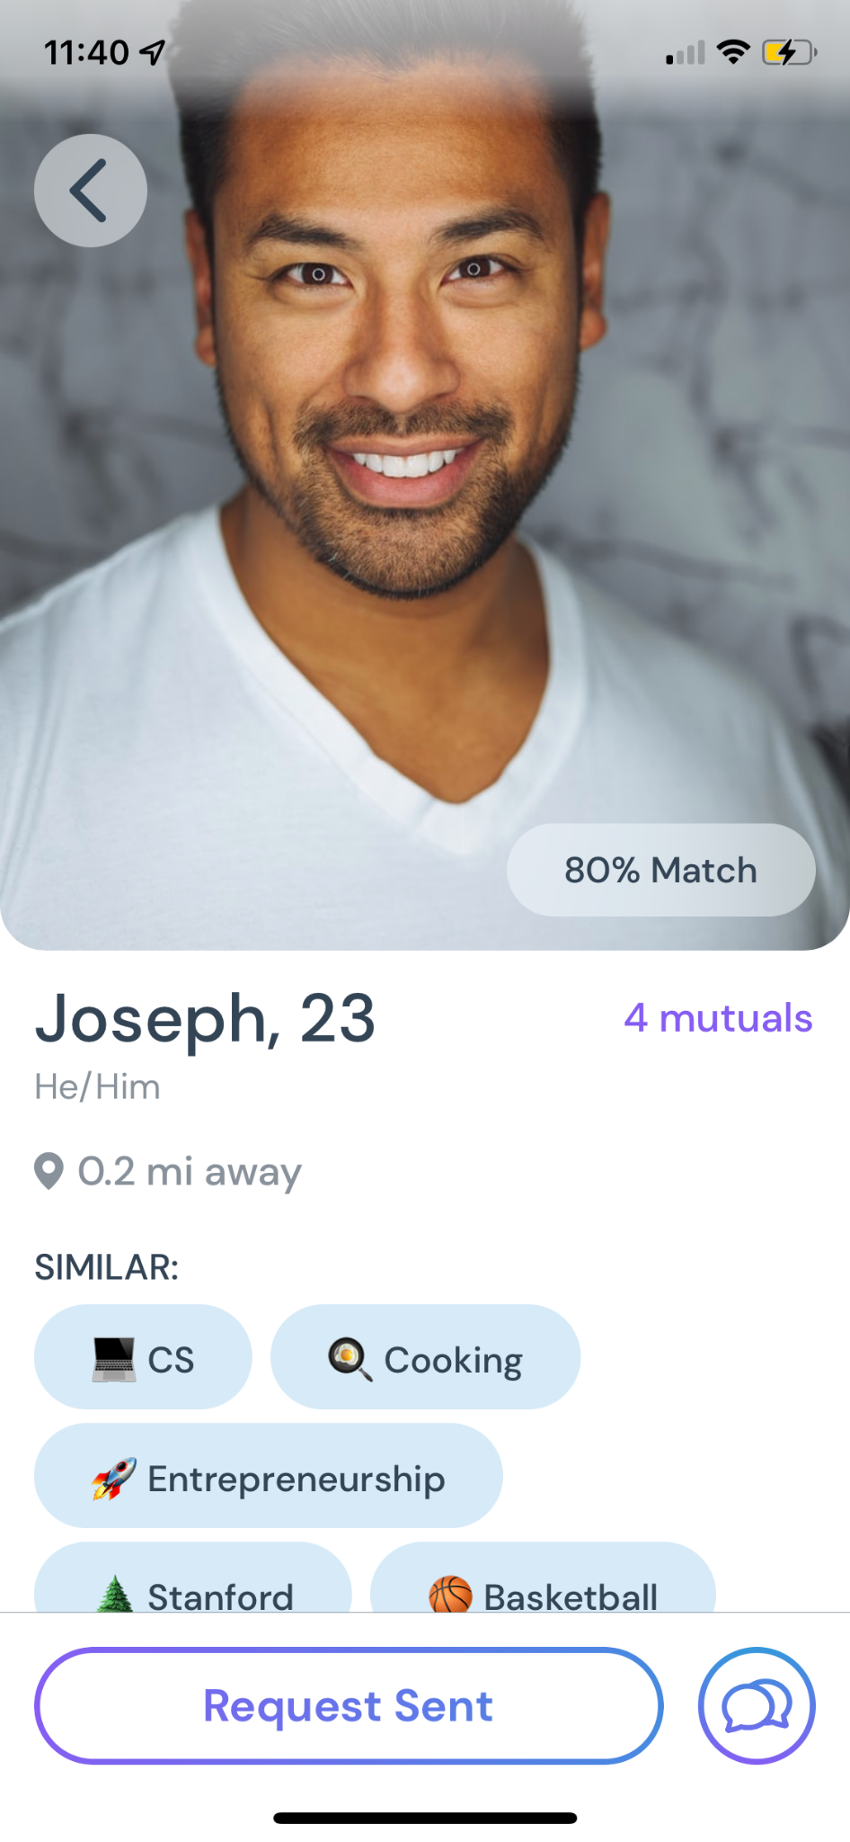
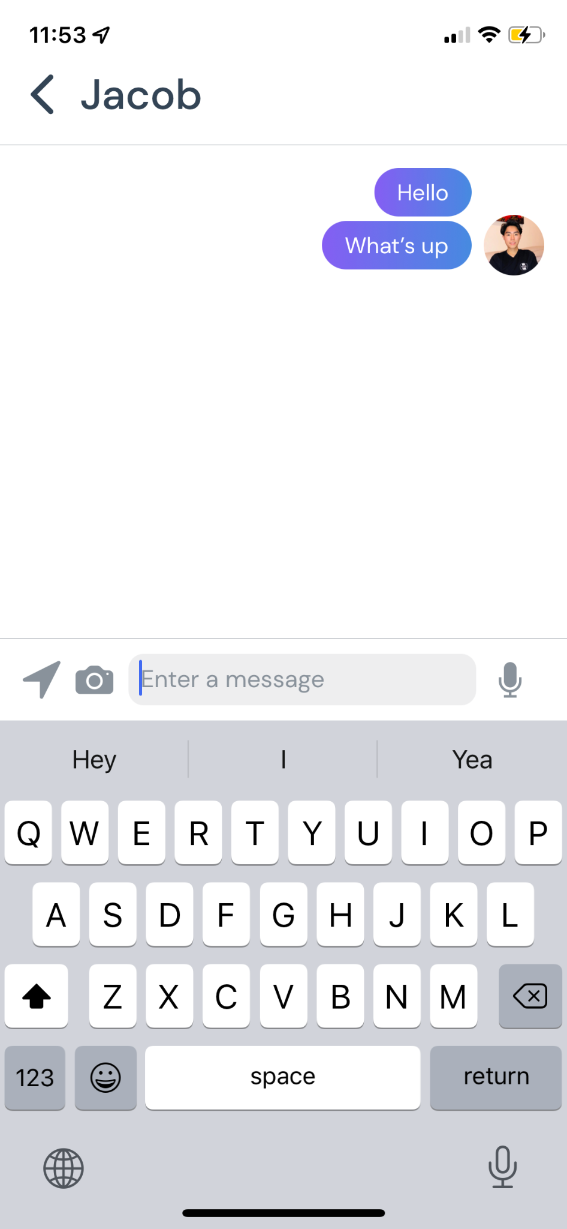
🚧 Complex Task 3 is a Work in Progress
Intro > HE > Revisions > Prototype > Demo
PREVIEW
Connect with and reach out to a past friend
Click on other person’s profile and message
View friend network
Friend suggestions

Slide 42
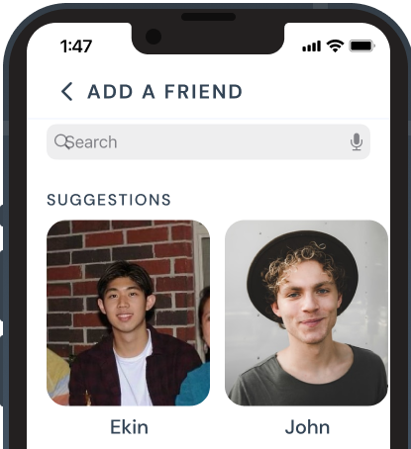
Wizard of Oz Techniques
Intro > HE > Revisions > Prototype > Demo
Matching Algorithm
Suggestions to Add to Network
A suggestions algorithm would be impractical without having existing users, so we make fake suggestions for past friends to add on the platform.
No matching algorithms, so we act as the matching algorithm by hard coding fake match scores.

Slide 43
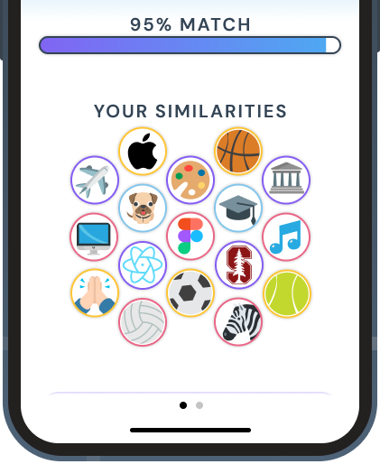
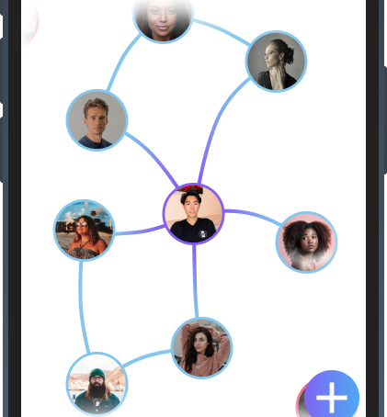
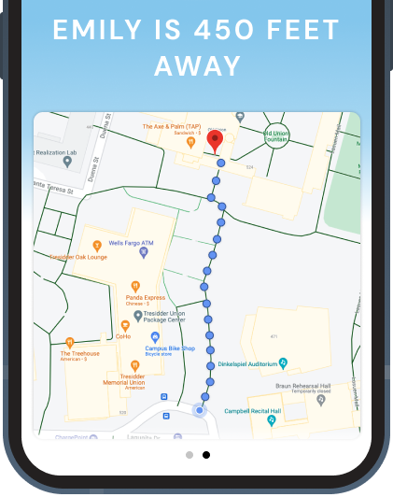
Hard Coded Features
Intro > HE > Revisions > Prototype > Demo
Map to Find Match
Network
Profile Information
We use a screenshot from Google Maps, and do not use any real location information.
All connections to other users on the platform at each time stamp are manually created.
WHY Hard Coded?
No users on the platform,
No way to extract this information (profiles and location)
not necessary to test user experience and task flows.
All profiles, shared interests, and match scores are hard-coded elements in all screens.

Slide 44
🛣️ Roadmap
Intro > HE > Revisions > Prototype > Demo
Task 1
✔️
🗺️ Share Location…
Task 2
Task 2
🧍 Past Friend Profile…
💬 Messaging
Task 3
Task 3
Complete
Todo

Slide 45
🛣️ Unimplemented Features
Intro > HE > Revisions > Prototype > Demo
Messaging System
Exchange Location
Self-Profile Screen*
Addressing Additional Violations in App
Privacy concerns through help screen

Slide 46
Prototype Implementation
Issues / questions

Slide 47
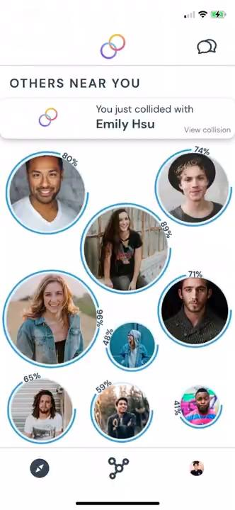
Demo of Prototype

Slide 48
Summary
🔒
👀
👨‍🦯
Med-Fi Prototype
Heuristic Evaluation
Hi-Fi Prototype
Next Up!
Notes:
And we hope that collide gives you a reason to find your next best friend

